Slide 1
Bluetooth Door Using HC-05

Slide 2
Name | ID
Mohamed Ali Sayed | 191900165
Islam Osama | 191900044
Kirolos Osama | 191900016
Abanoub Ibrahim | 191900276

Slide 3
Table of contents
01
02
03
04
Abstraction
Objectives
Methodology
Tools

Slide 4
Table of contents
05
06
07
08
FlowChart
Blockdiagram
Simulation
video

Slide 5
01
Abstraction

Slide 6
Abstraction
A controlled door from telephone using Bluetooth sensor is a project that involves using a Bluetooth module to remotely control a door lock from a mobile phone. This project is useful in situations where you want to provide secure access to a room or building while also having the ability to control access remotely.

Slide 7
02
Objectives

Slide 8
A controlled door from telephone using Bluetooth sensor is a simple and effective solution for providing secure access control to a room or building while also allowing for remote control via a mobile phone.

Slide 9
03
Methodology

Slide 10
Methodology
To implement this project, you will need to connect a Bluetooth module to the Atmega32 microcontroller and then program the microcontroller to read commands from a mobile phone and control a door lock accordingly. You will also need to install a door lock mechanism that can be controlled by the microcontroller

Slide 11
04
Tools

Slide 12
Tools (components)
Atmega32A
HC-05
DC Motors
Small Door
Motor Drive L298N

Slide 13
05
Flowchart

Slide 14
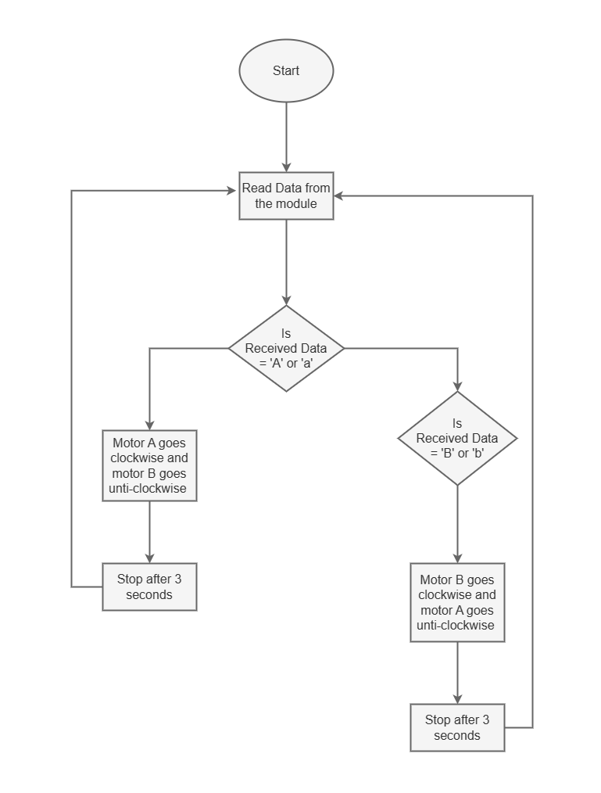
Flowchart

Slide 15
07
Block Diagram

Slide 16
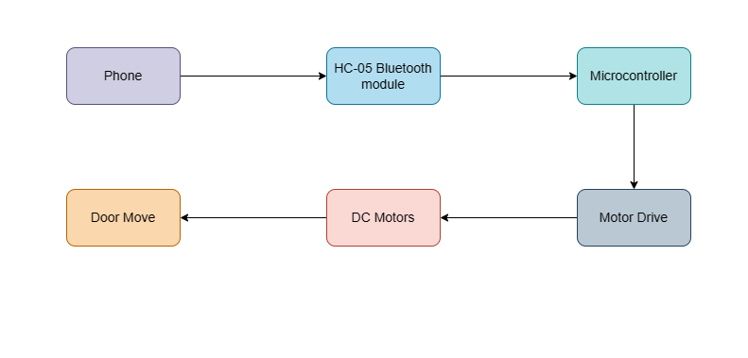
Block Diagram

Slide 17
08
Simulation

Slide 18
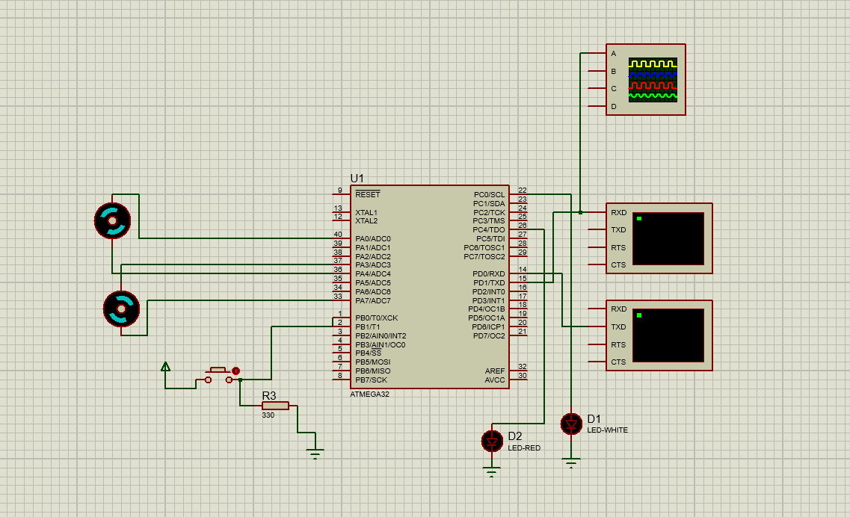
Simulation

Slide 19
08
Videos

Slide 20
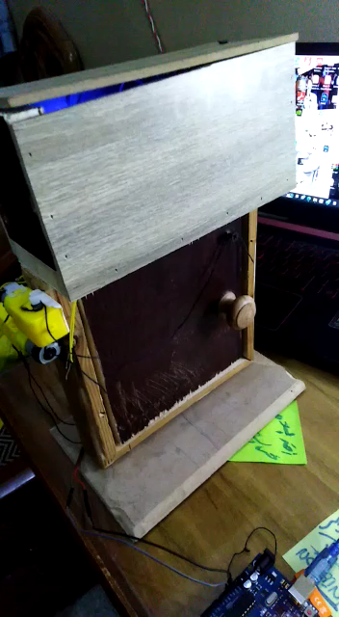
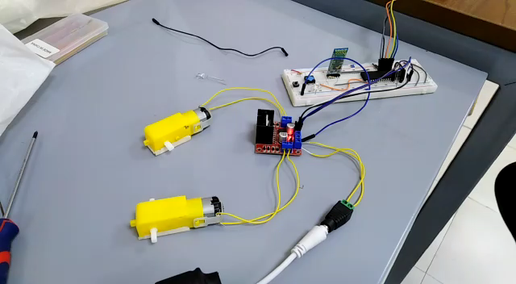
videos

